Slide 1
BIG DATA ANALYTICS CSC – 3303 TEST: 2
Lecturer: Dr. SHARYAR WANI

Slide 2




Submitted by:
Name: Hasan Tanveer Mahmood
Matric: 1725413
BCS, Information & Communication Technology
International Islamic University Malaysia
Email : tanveer.iium@gmail.com

Slide 3
Dataset Description
The 2 datasets have been given, which is CSV file
1. Survey Data Demographic
2. Survey Data Technologies normalized
Survey Data Demographic have 71 columns and Survey Data Technologies normalized 14 columns

Slide 4
Dataset Description
Survey Data Demographic:
The dataset contains more than 11000 values which has described the result from the survey in a tabular format, there are personal enquiry of the survey person and his/her opinions including social media, salary, age, gender, dependents and so on
Survey Data Technologies normalized:
This dataset has more than 7000 values where it is shown that the technology in the computer science field and its demand in the upcoming year.
I have to clean datset first. Because dataset are not cleaned.

Slide 5
Data Science Question:
which social media influenced most for choosing ?
Which country people have chosen their profession as Developer most?
How often people tend to feel open to new opportunities?
How often people’s desire of platform change?
Depends on satisfaction level how satisfied they are as a developer?

Slide 6
Objective:
Need To Come up with an analysis with proper data science question
Need To compare the columns of the dataset and create relation
Need To Identify the main motive of the dataset
To make queries to sort out useful information for EDA.

Slide 7
Methodology:
Data sets: The data set are given.
Tools Used:
Google Colab
Library Used:
pandas, numpy, matplotlib.
Using plot functions to visualize.
Spark

Slide 8
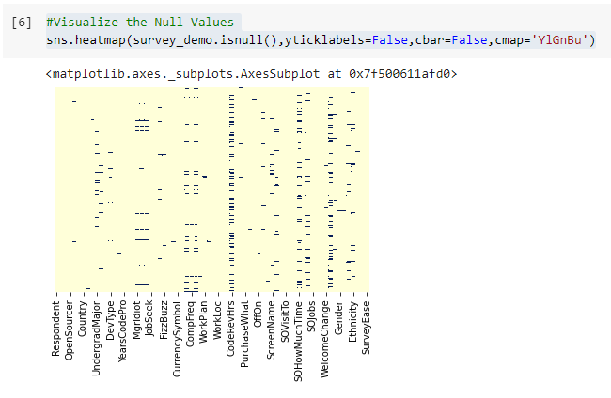
Results & Visualizations (Data set 1):
Check the null values
Here we can see that there are null values in some column
So, I have to work on it.

Slide 9
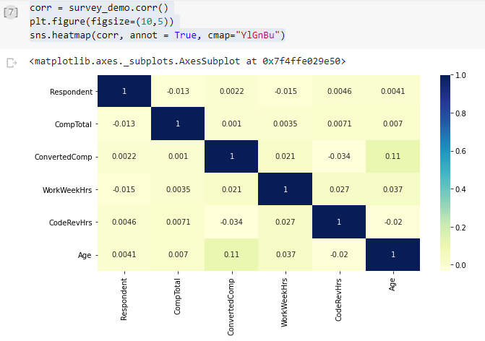
Results & Visualizations (Data set 1) (Cont.):
Here I tried to show the correlation among the column

Slide 10
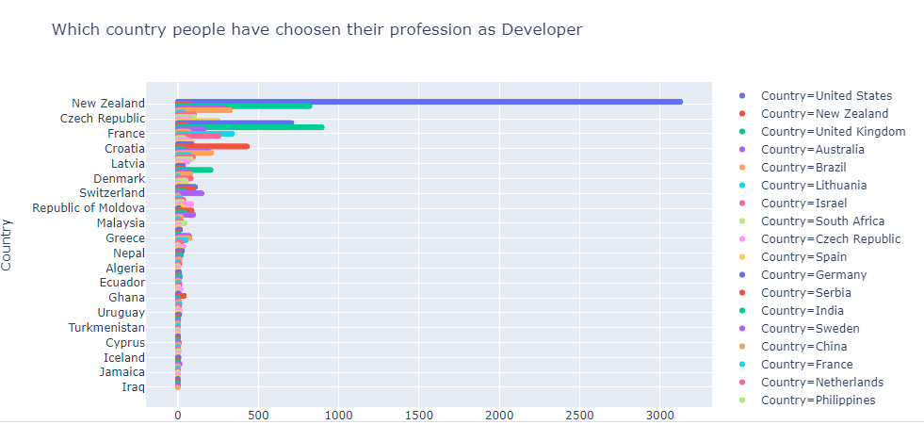
Results & Visualizations (Data set 1) (Cont.):
This bar plot shows “Which country people have chosen their profession as Developer most ”

Slide 11
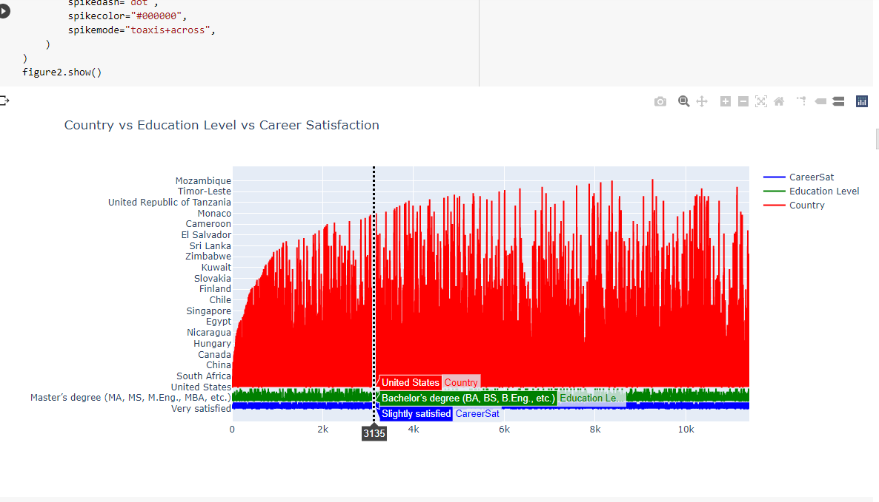
Results & Visualizations (Data set 1) (Cont.):
This line graphs shows the “Country vs Education Level Vs Satisfaction” about their job as developer

Slide 12
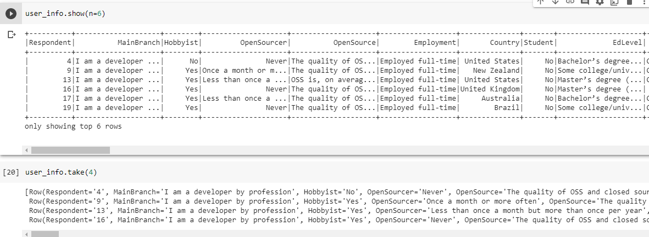
Results & Visualizations (Data set 1) (Cont.):
Here I have used Spark to describe the dataset

Slide 13
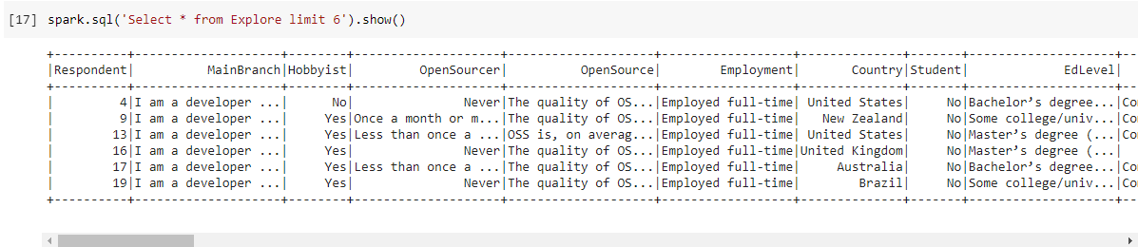
Results & Visualizations (Data set 1) (Cont.):
Here I have used Spark to for data Querry.

Slide 14
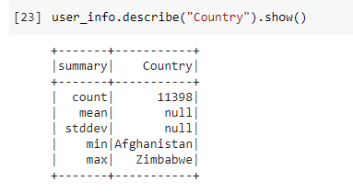
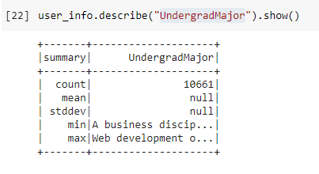
Results & Visualizations (Data set 1) (Cont.):
Here I try to make a Query which shows that in undergrad level how many student took computer science in their bachelor degree.
And the country

Slide 15
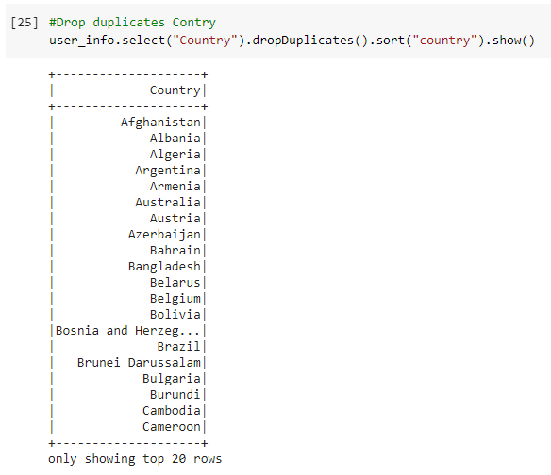
Results & Visualizations (Data set 1) (Cont.):
Here I have Deleted the Duplicate Value with spark.

Slide 16
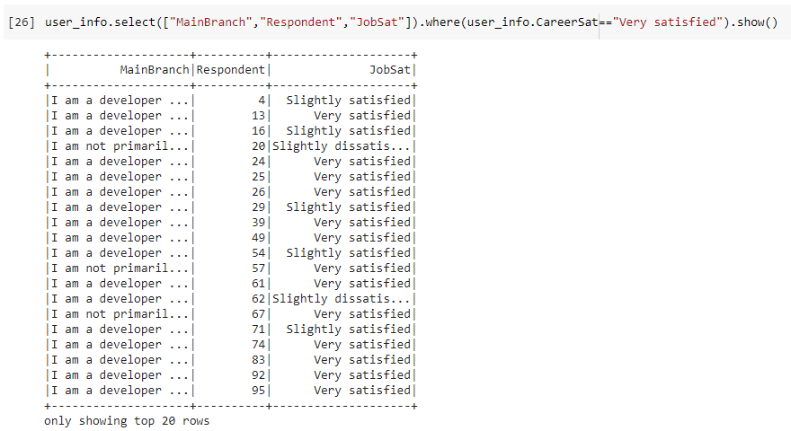
Results & Visualizations (Data set 1) (Cont.):
Here I’ve tried to show the job satisfaction

Slide 17
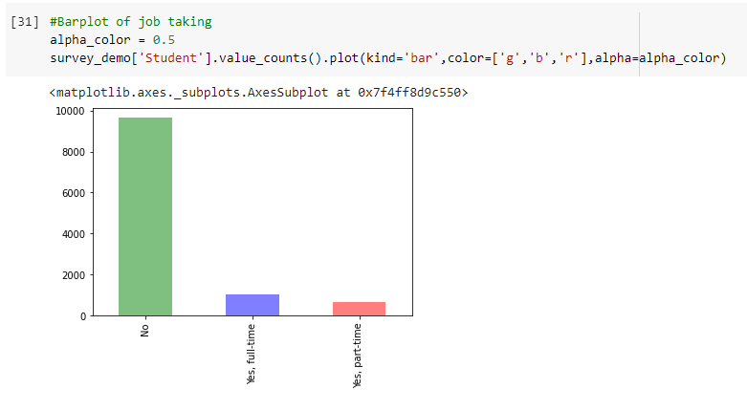
Results & Visualizations (Data set 1) (Cont.):
Who took developer job full time, part time, No

Slide 18
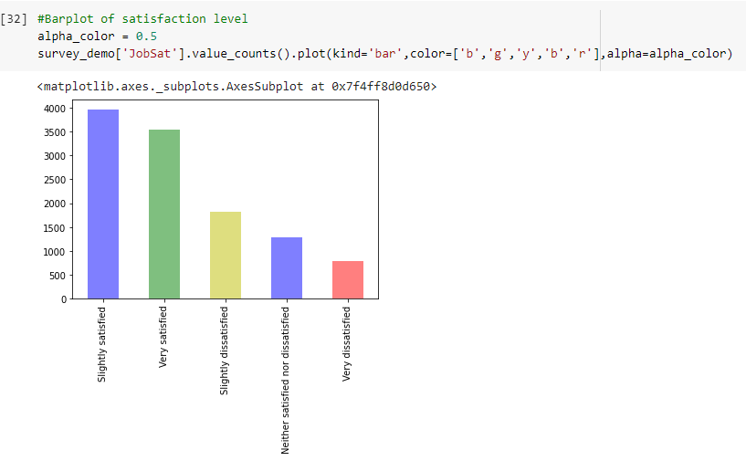
Results & Visualizations (Data set 1) (Cont.):
Here I tried to show, Their satisfaction level

Slide 19
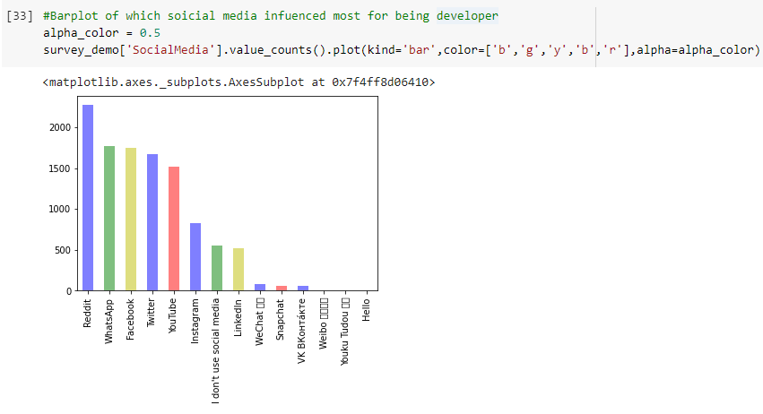
Results & Visualizations (Data set 1) (Cont.):
Here I tried to show, which social media influenced most

Slide 20
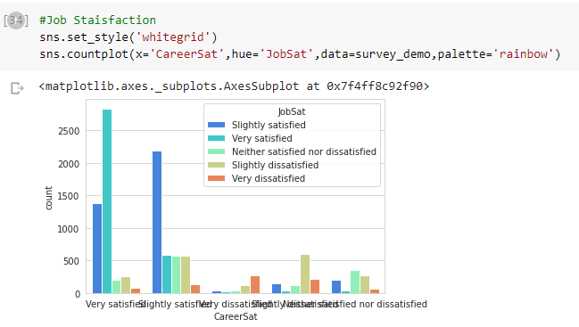
Results & Visualizations (Data set 1) (Cont.):
Here I tried to show, group the satisfaction level

Slide 21
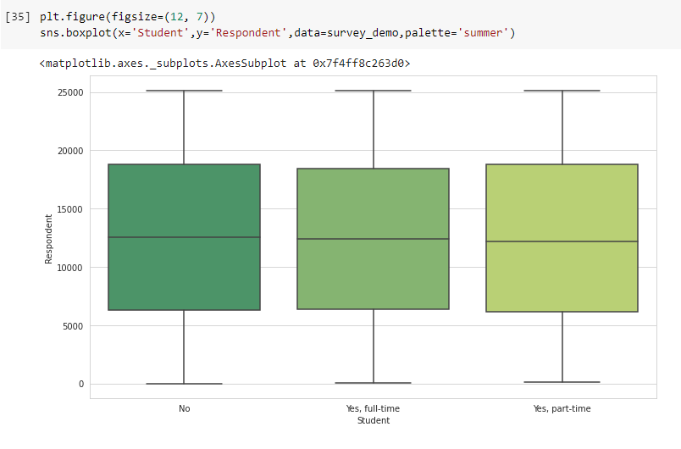
Results & Visualizations (Data set 1) (Cont.):
Here I tried to show bar plot for job level

Slide 22
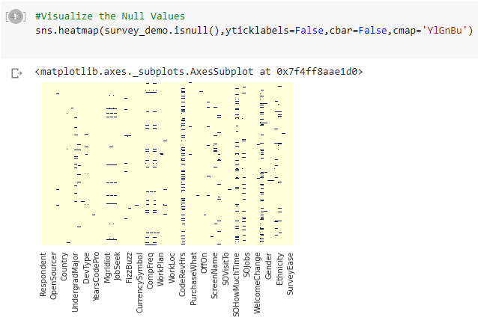
Results & Visualizations (Data set 2) :
Null Value for data set 21

Slide 23
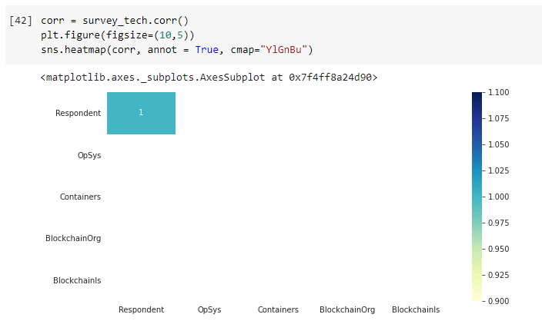
Results & Visualizations (Data set 2) :
Correlation among the column.

Slide 24
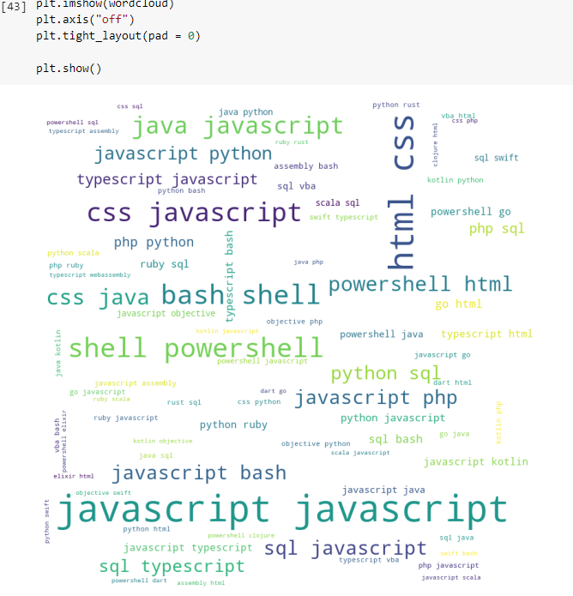
Results & Visualizations (Data set 2) :
Word Map for the developer languages.
Here Most Popular Languages has occurred mostly.

Slide 25
References:
https://matplotlib.org/tutorials/introductory/pyplot.html
https://pynative.com/python-matplotlib-exercise/

Slide 26

Thank You.

